Slide 1
Good Practice Programme
NPEG Behaviour Change
17.10.18

Slide 2
Agenda
Original Proposal & Programme
Ignite stage overview
Empower stage overview + overall feedback
Grow stage – looking forward

Slide 3



Delivery Agent
Adam Woodhall

Slide 4
Why?
Sharing costs when resources are constrained
  (projects developed and shared amongst group)
Helping to promote behaviour change as a group where individuals may struggle
Sum is greater than the parts
  (specialism, professional backgrounds, different perspectives)

Slide 5
Programme overview
Six pilot orgs identified (+FTE):
  Police
    South Yorkshire
    Humberside
    Avon & Somerset
    Scotland
  Fire
    London
    Manchester
Budget – £19.5K:
  NPEG - £9K
  Each Police Force - £1.5K
  Each Fire Service - £2.25K
Programme
  Start: Spring 2017
  Scheduled completion: Autumn 2018

Slide 6


Adamm: Consultant + Coach
40%
60%

Slide 7
Adoption of innovation
Tipping Point
Innovators
2.5%
Early
Adopters
13.5%
Early
Majority
34%
Late
Majority
34%
Change Averse
16%

Slide 8
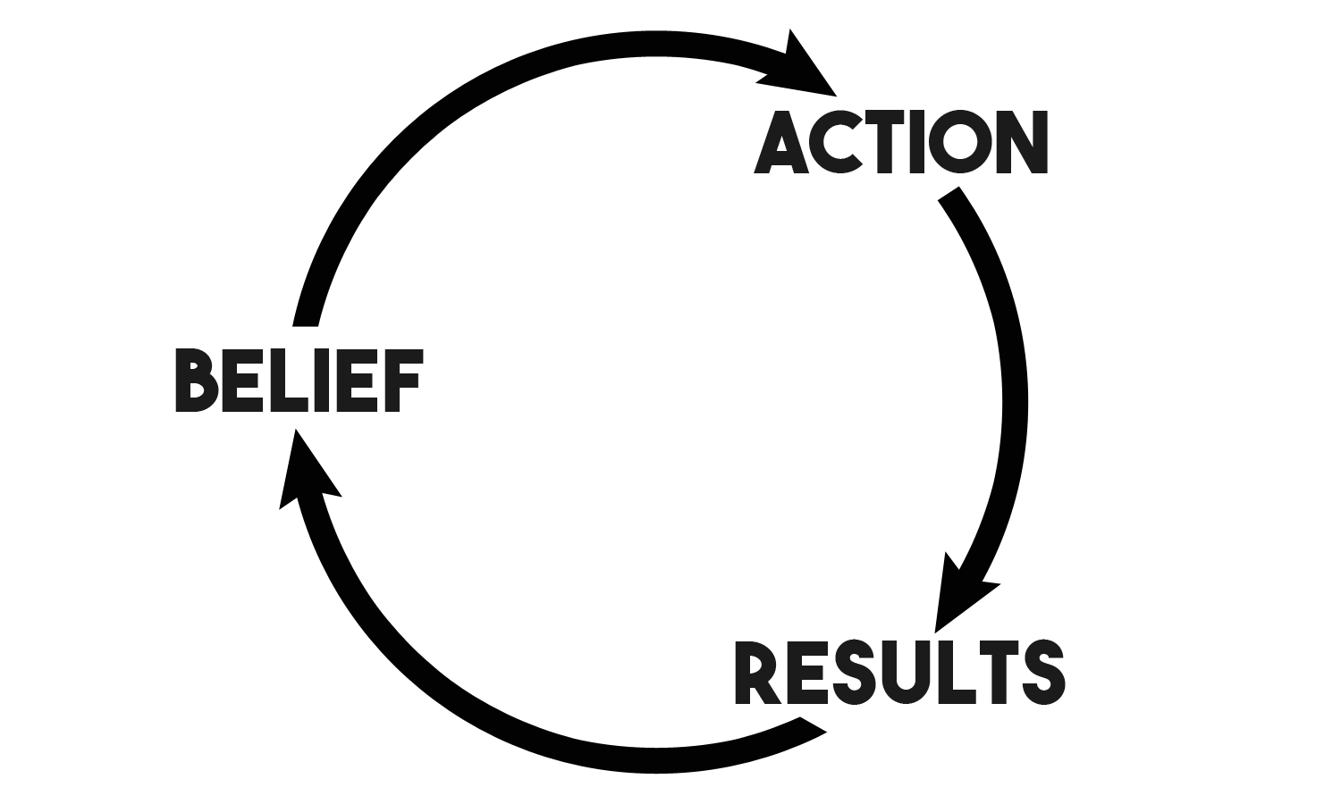
Action or Belief: which comes first?
Focus of this programme

Slide 9
Smart Change – constant action
Ignite
Empower
Grow

Slide 10
Smart Change – constant action
Evaluate situation
Create coalition
Develop strategy
Communicate approach
Celebrate & momentum
Accept & Learn
Support ownership
Demonstrate value
Cultivate sustainability
Ignite
Empower
Grow

Slide 11
Programme
Phase 1
  12 months – start April 2017
  Action Pilots in 4 forces + 2 Fire Service (first 6 sub-stages of Smart Change)
  Engage & understand rest of orgs (first 2 sub-stages of Smart Change)
Phase 2
  2-3 months – start mid 2018
  Best practice collation & report: Understand what has/hasn't worked in Action Pilots, consider how this may apply to other forces, and develop strategy. Report produced to summarise these findings
Phase 3
  2-3 months – complete by late 2018
  Best practice ‘product’ creation & delivery - one or combination of: hard copy guide, videos, online training, workshops (3rd sub-stage of Smart Change)

Slide 12
Outcome of full programme
Pilot forces achieve 5-10% energy, resource & cost saving
Proof of concept
Learning what works (and doesn’t)
Wider momentum generated through programme
Delivering an engaging method of sharing best practice (i.e. the ‘Product’) to maintain momentum and share learning
Collaboration between Forces
Inspiring and empowering action
Skills and confidence building
In the long term, embed behaviours into the organisations

Slide 13
Ignite
Empower
Grow

Slide 14
Ignite programme
Full day meets with sustainability reps of pilot forces in London
Numerous 1-on-1 and conference calls
Visited all six organisations
Met with 60+ people including:
  20+ operational officers
  One Assistant Chief Officer
  The ‘staff’ came from across:
    IT
    Finance
    Fleet
    Estates
    Procurement
    Facilities Management
    Business Managers
    HR
    Union Reps

Slide 15
FTE to Susty FTE
* Updated slide will be sent when I have info from the teams

Slide 16
Manchester: SWOT

Slide 17
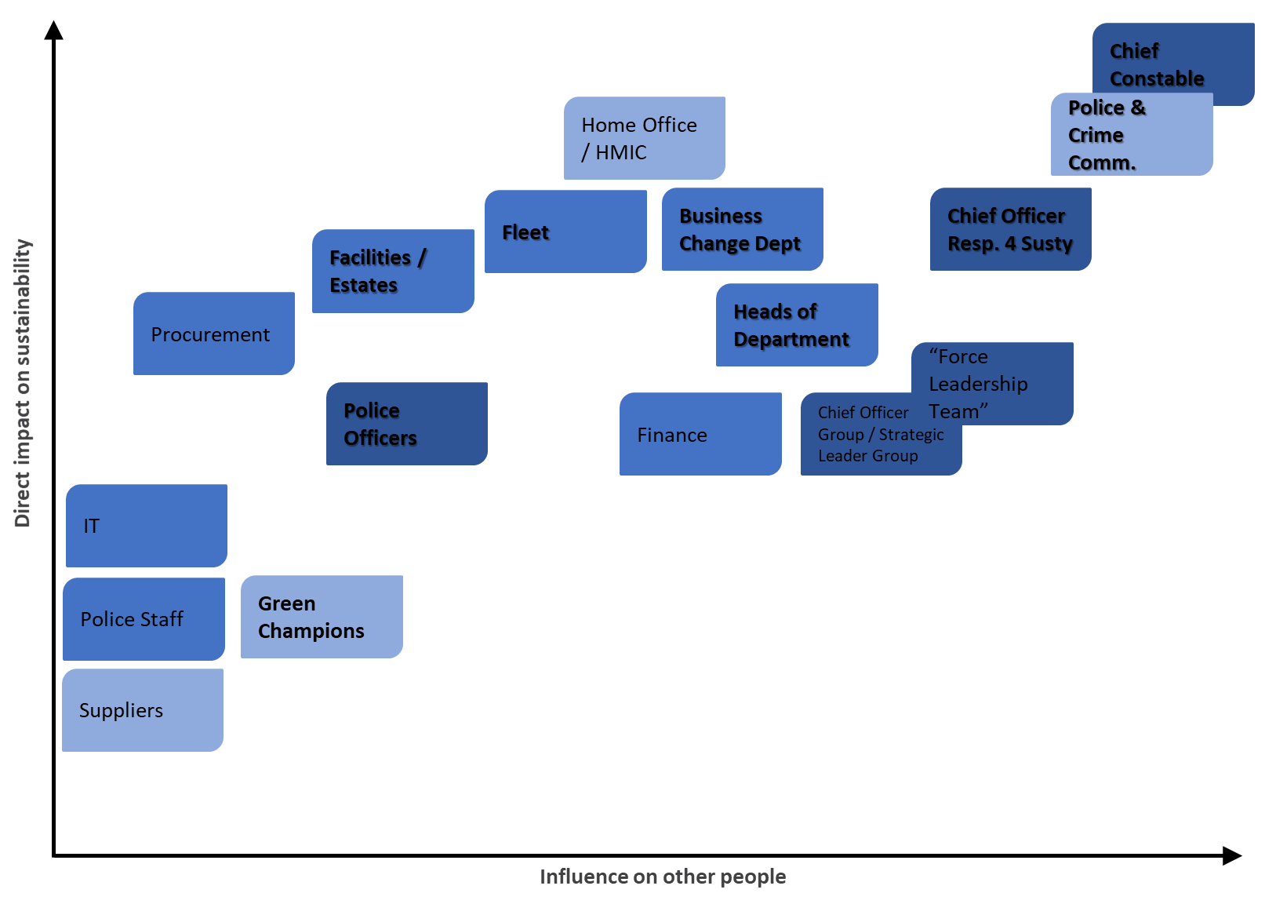
South Yorks: Stakeholder Map

Slide 18
Avon & Somerset: SWAN

Slide 19
London: Susty Development Level

Slide 20
Sustainability focus: Police
Business travel
Water
IT
Pollution prevention
Paper
Other consumables
Biodiversity
Commuting
Health & Wellbeing
Energy
Waste
Fleet Fuel

Slide 21
Sustainability focus: Fire
Travel to work
Health & Wellbeing
Food & Diet
Incidents
Water
Recycling
Biz Mileage
Env. Protection
Buildings Energy
Waste Volume
Single Use
Video Conf (L)
Procurement (M)

Slide 22
Smart Change – constant action
Ignite
Empower
Grow

Slide 23
What is Empowered Change?
“Empowered change is when people choose to take ownership and feel capable of positive action to deliver it”
Action creates belief

Slide 25
KPIs: Avon & Somerset (original)

Slide 26
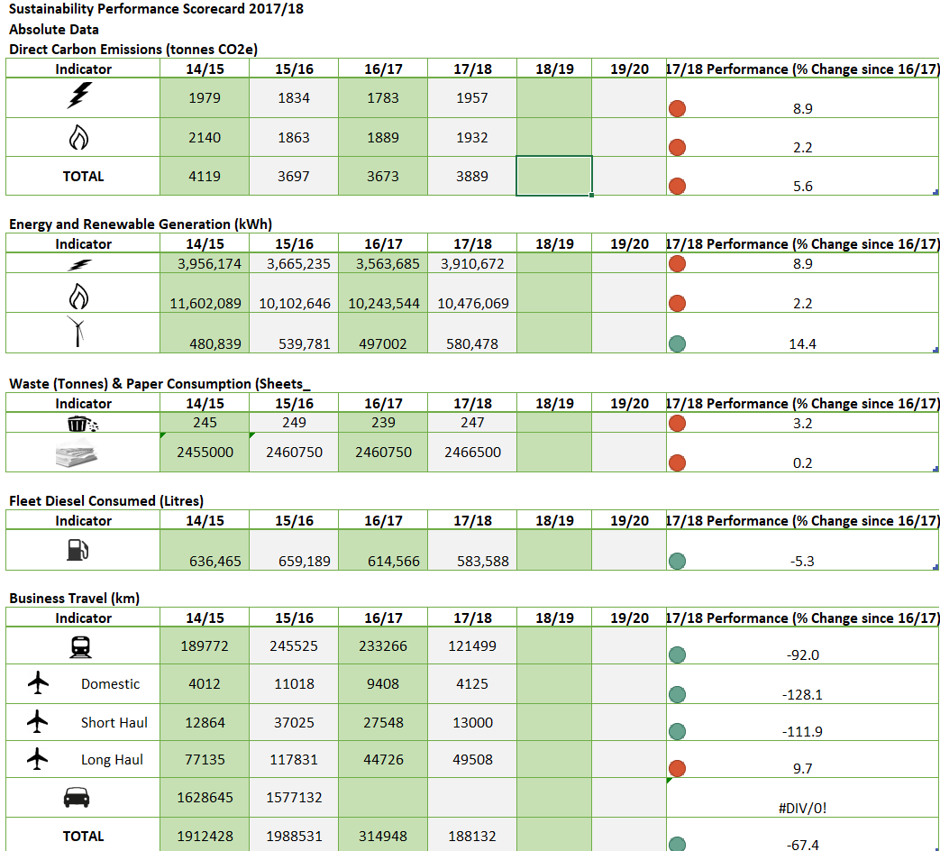
KPIs: Manchester (adapted)

Slide 27
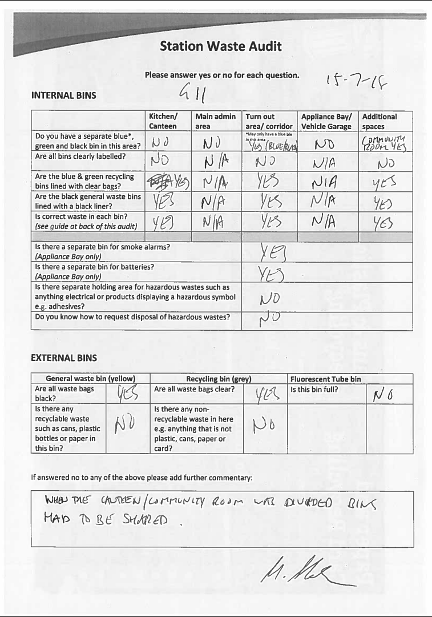
Waste

Slide 28
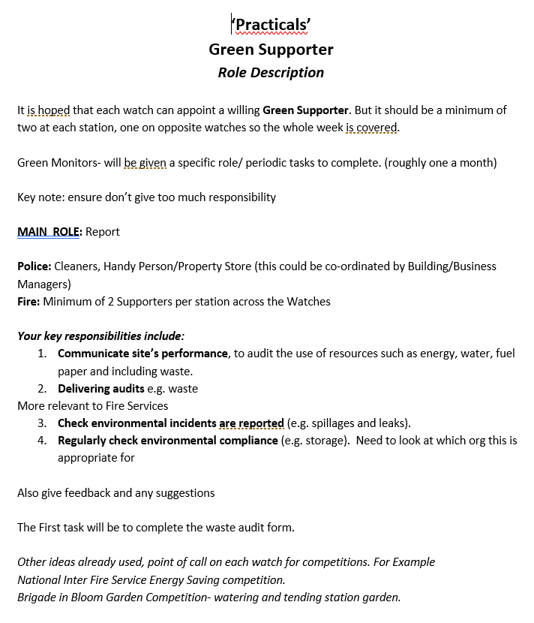
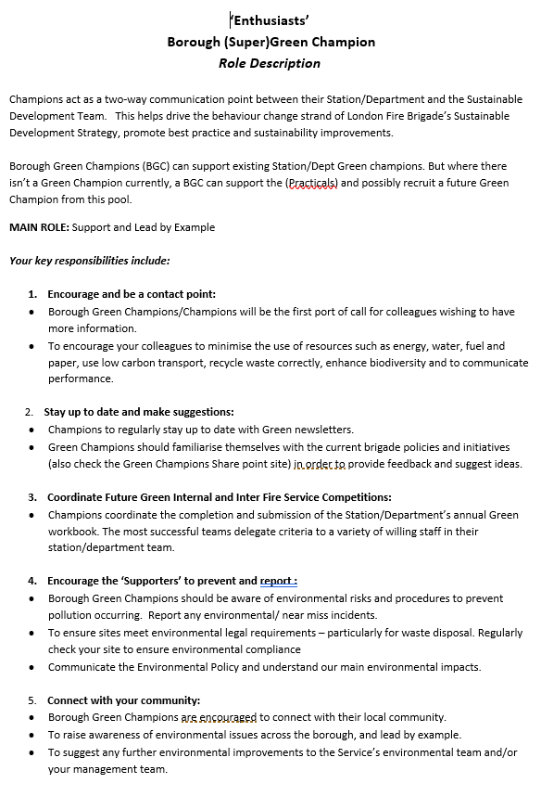
Champions

Slide 29
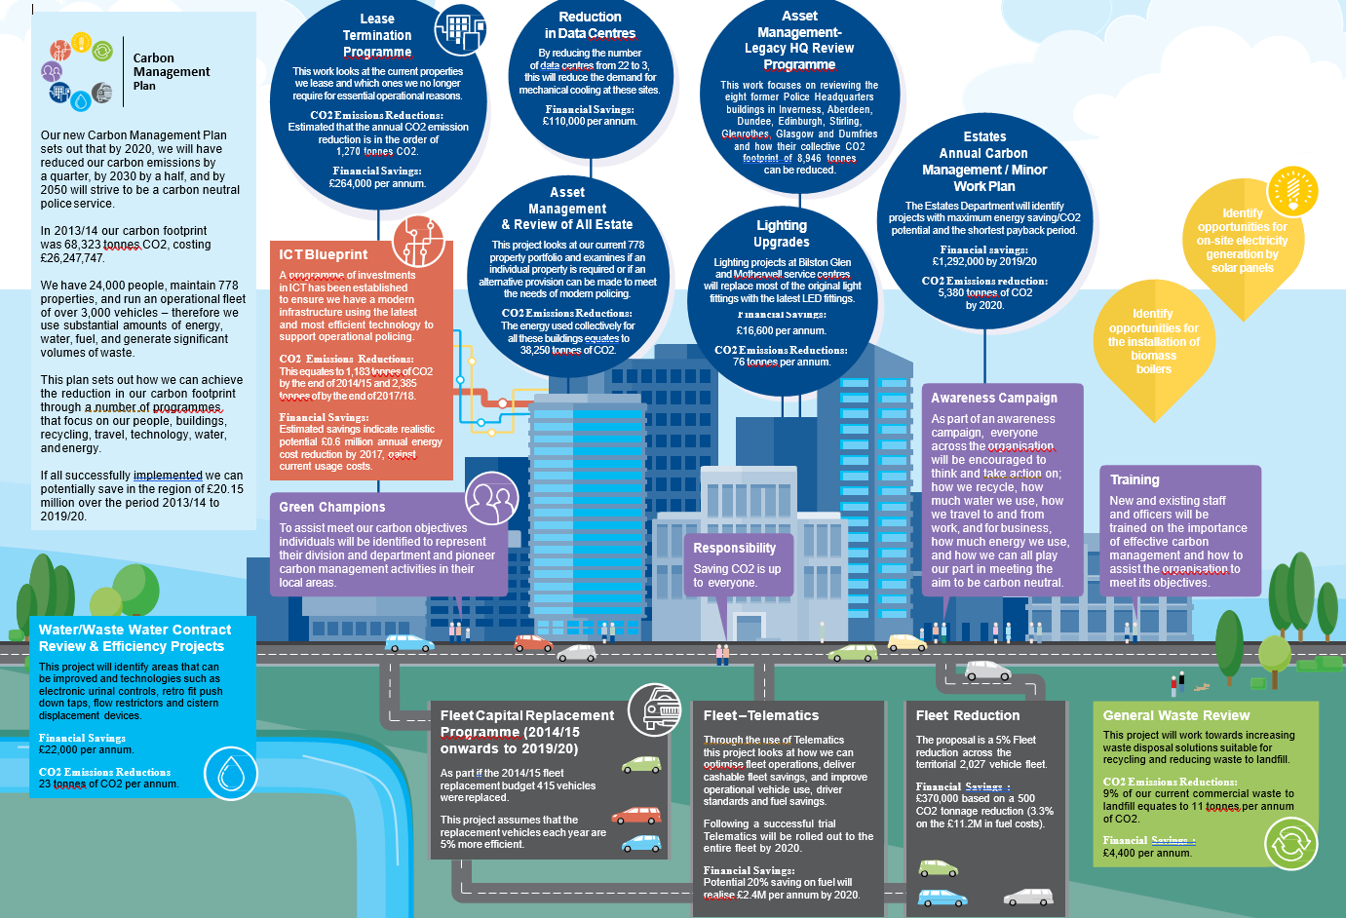
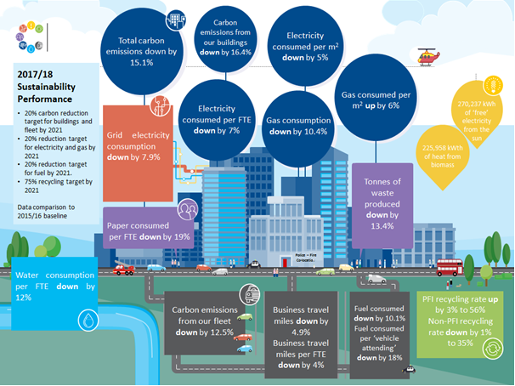


Slide 30


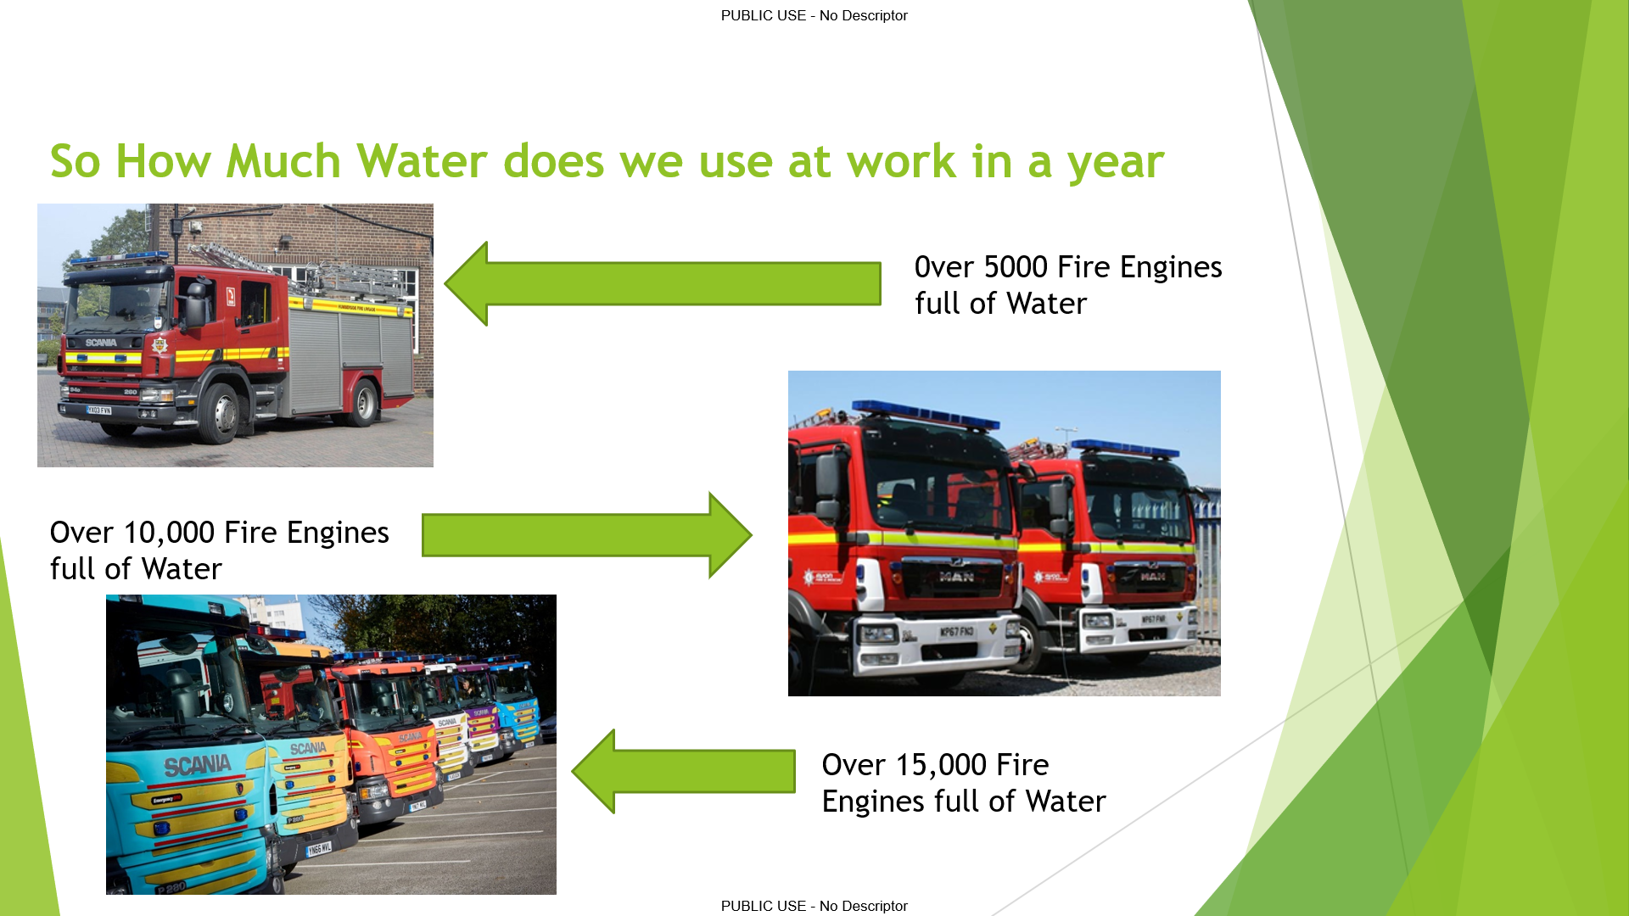

Quiz - Humberside

Slide 31
Progression
Virtual Susty Team
“Switch On our organisations on to Sustainability”
(Proactive)
Behaviour Change Working Group
“Switch Off Campaign” (Reactive)

Slide 32
“What have you got out of this?”
Hannah Watts – Avon & Somerset Police
  “Organised opportunity to share learning, experiences & work with likeminded individuals”
Steven Thomson – Police Scotland
  “Having a list of contacts being able to share best practice among like minded organisations”
Peter Robinson – Humberside Police
  “The group has highlighted more options available for me to look and address. It is great that the group will be continuing to work together.”

Slide 33
“What have you got out this?”
South Yorkshire Police
1. Reassurance
2. Learning
3. Inspired
4. Motivation

Slide 34
“Where are you at with embedding?”
Hannah Watts – Avon & Somerset Police
  “From perspective of behaviour change – difficult to quantify”
  “Culture changing of organisation over time. Not easy – becoming less difficult”
  “Doing some work around mission / vision / values – looking at how sustainability fits”
Steven Thomson – Police Scotland
  “Sustainability not high on organisations agenda currently, but Scottish Government is laying foundations”
Peter Robinson – Humberside Police
  “It is difficult for a number of reasons: Getting senior officer involvement is difficult and as a force we need them to buy into sustainability.”
  “In addition this is a part time role as I deal with other works i.e. building infrastructure. However this is a bonus when refurbishing a building as I can ensure that sustainability is included within the refurbishment.”

Slide 35
Programme
Phase 1
  12 months – start April 2017
  Action Pilots in 4 forces + 2 Fire Service (first 6 sub-stages of Smart Change)
  Engage & understand rest of orgs (first 2 sub-stages of Smart Change)
Phase 2
  2-3 months – start mid 2018
  Best practice collation & report: Understand what has/hasn't worked in Action Pilots, consider how this may apply to other forces, and develop strategy. Report produced to summarise these findings
Phase 3
  2-3 months – complete by late 2018
  Best practice ‘product’ creation & delivery - one or combination of: hard copy guide, videos, online training, workshops (3rd sub-stage of Smart Change)

Slide 36
Smart Change – constant action
Ignite
Empower
Grow

Slide 37
Grow
Fit around 2 NPEG Environment Sub-Group meetings per year – 2 per year (ideally day before)
Everyone has projects – where possible pairing happens – potential for a lead and a support on projects
Conference calls every six weeks – 30min
Investigate shared document spaces everybody can access
  Inc. repository of findings from Ignite & Empower
Secretariat – coordinating the timings

Slide 38
Consultants Feedback
Challenges
  Sustainability has a lot of paperwork
  Senior leadership support is key
  Tracking ‘behaviour change’ is very difficult, especially when under-resourced
Success Formula:
  Senior leadership belief + Time invested = success
How to apply across other orgs:
  Primary investment focus: staff time
  Adapt tools to organisational situation

Slide 39
Outcome of full programme
Pilot forces achieve 5-10% energy, resource & cost saving
Proof of concept
Learning what works (and doesn’t)
Wider momentum generated through programme
Delivering an engaging method of sharing best practice (i.e. the ‘Product’) to maintain momentum and share learning
Collaboration between Forces
Inspiring and empowering action
Skills and confidence building
In the long term, embed behaviours into the organisations

Slide 40
FTE to Susty FTE
* Updated slide will be sent when I have info from the teams

